Slide 1
Topic: The order of operations
EQ :What is important to remember when we use a number line? (revision)
First topic so don’t forget to add to Contents page in INB
Get your VIVOS
- Number Ninja???????

Slide 2
24
7
30
Date
The order of operations
EQ – What is important to remember when we use a number line?
0
12
0
12
Teacher notes:
1. Draw 2 lines on the board, one long one and one really short.
2. Label both lines as 0 to 12
3. Ask students to place 6 on each line and explain their reason.
4. Introduce the terms starting number, ending number and midpoint.
5. Ask Do number lines have to start at 0?
6. Extend to get students to find the midpoint on a line starting between 2 and ending in 12.
7. Share what students have done (students may fold the paper; students could use the ruler, students could use knowledge of numbers, students may use addition or subtraction or difference between)

Slide 3
24
7
30
Date
The order of operations
EQ – What is important to remember when we use a number line?
Teacher notes:
Can you have numbers less than 0 on a number line? What are they called? What does the number line look like?
8. Now get students to extend thinking again with the following: Draw a line with 4 in the midpoint and 12 at the end. What is the starting number? (so that they have to find that -4 goes at the start).
9. How many numbers between -4 and 1 or 6 and -5?
10. What maths is happening here? (adding/subtracting)

Slide 4
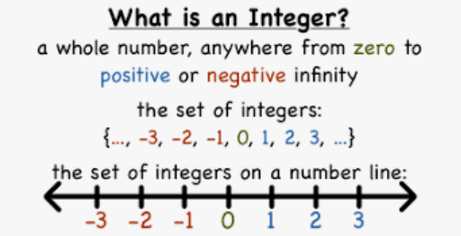
24
7
30
Date
The order of operations
EQ – How to add and subtract integers?
One definition you will need to know for next lesson:
Integers

Slide 5
24
7
30
Date
The order of operations
EQ – How to add and subtract integers?
Summary:
Number lines are another way to represent numbers
Reflect and then write about the key features of a number line and how to identify them

